Slide 1
Privacy-ensuring fall detection using mmWave technology
Abanob Tawfik
z5075490

Slide 2
Falls
One of the biggest causes of fatal and non-fatal injuries amongst people
According to the World Health Organisation
Falls are the second leading cause of accidental or unintentional injury deaths worldwide
Each year approximately 646,000 people die from falls globally
Adults over the age over 65 tend to suffer the greatest number of fatal falls
37.3 million falls occur each year that require medical attention
Notes:
A quick recap on what my thesis is all about
This has led to the need for fall detection, especially for elderly people as falls can render a person unconscious for potentially hours, if no one has found out they had fallen they could be there for hours.

Slide 3


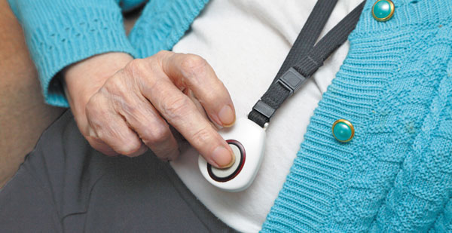
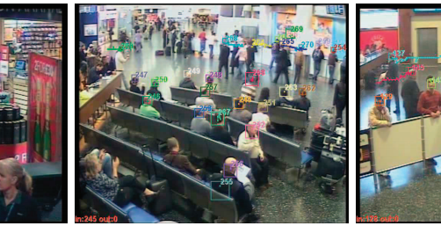
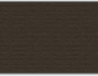
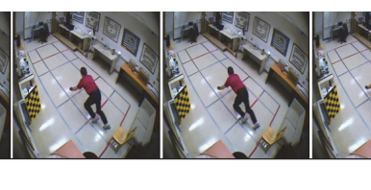
Problems in Fall Detection
Phone and sensor based fall detection methods can be problematic
Camera-based monitoring requires data for training which is often unacquirable as:
Falls are unlikely events
It is unethical to ask elderly people to fall
Training data from healthier younger people cannot simulate a real natural fall
There is still no standard for fall detection that performs consistently well
Camera-based monitoring raises privacy concerns
Notes:
This has led to the need for fall detection, especially for elderly people as falls can render a person unconscious for potentially hours, if no one has found out they had fallen they could be there for hours.
Because they require a burden of responsibility on the user, the person is required to have their device on them at all times, in this image they need to actually press the button which can be unrealistic if they are unconscious
Privacy concerns, its like 24/7 surveillance, constant monitoring with your face in plainsight, most people feel uncomfortable under suirvallence.

Slide 4
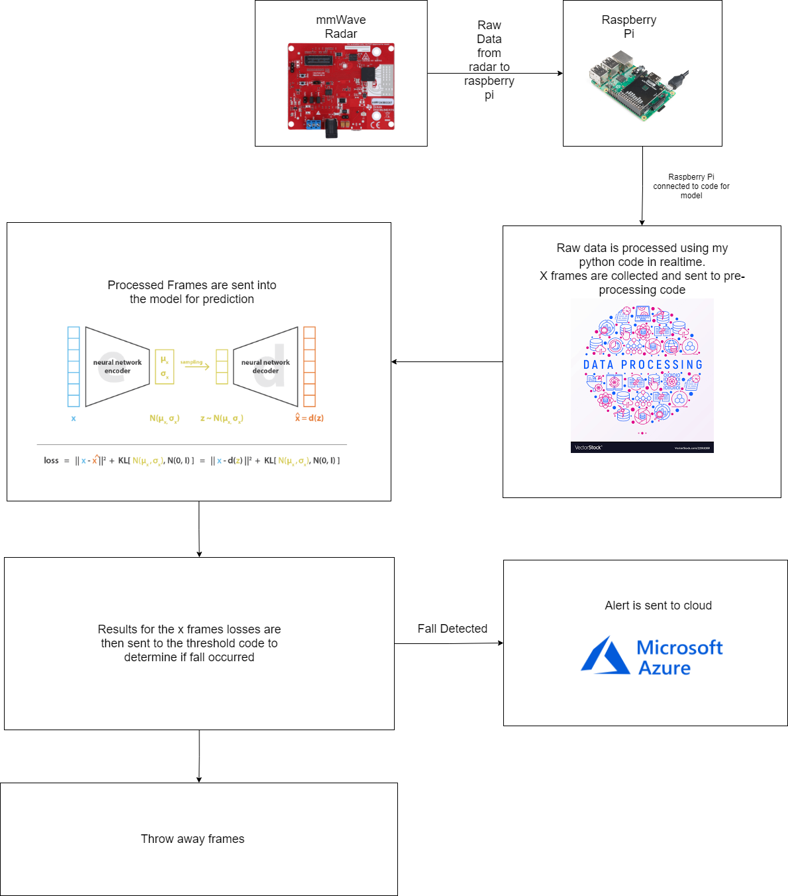

A High Level View
Notes:
Here is a high level view of what I aimed to accomplish from my thesis
We start at the radar that collects raw mmWave data and sends it across to a rapsberyy pi
The raspberry pi has all the local code required to run the model, and sends the raw mmWave data into the pre-processing pipeline
After pre-processing the pre-processed data is sent into the model for an output and computes reconstruction loss
This loss value is then compared to a threshold determined through youden’s index to find an optimal threshold
If the value is over threshold -> send alert through azure function
If the value is not over threshold -> throw away frames its useless

Slide 5
Expected Outcomes
Create a data cleaning script in order to remove
Outliers
Invalid data inputs
Label data
Create a data pre-processing pipeline
Develop a model that uses a Variational Autoencoder with a RNN as the bottleneck

Slide 6
Expected Outcomes
Develop and implement code for Youden's index to determine optimal threshold
Achieve around 90% prediction accuracy
Develop a lightweight version of the code only requiring the model that can be ran in real-time
Develop an Azure function to alert some entity, triggered on detecting a fall.
Notes:
90% accuracy was based off a paper I had read in thesis A that achieved 98% accuracy on 50 total samples, so maybe shooting a bit too high

Slide 7
What Did I End up doing
Data Cleaning script
Data pre-processing
Developed the model
Threshold code (Thanks to Reza especially, credit where its due)

Slide 8
Methodology Data Cleaning
Requirement
turn the unstructured raw dump of mmWave data into organised samples
Label samples by their activities
Python script developed structures and labels raw mmWave dump into labelled activities with their frame data.
Python script is also able to capture the frames of a transition between two activities
Notes:
The next slide will show a sequence of images to visualise this cleaning

Slide 9
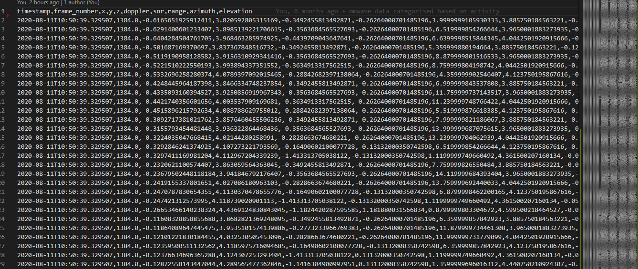
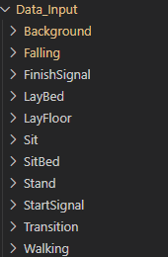
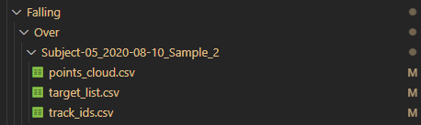
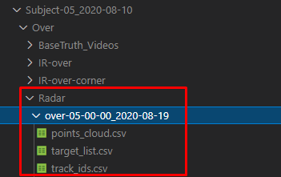
Methodology – Data Cleaning

Slide 10
Methodology Data Pre-processing
Requirement
Turn clean mmWave data into frame sequences that can be used by the model
Oversample all frames to have the same number of points
Checkpoint data during pre-processing to prevent unnecessary re-processing
Customisable hyper-parameters to modify training
Notes:
window size, window step size

Slide 11
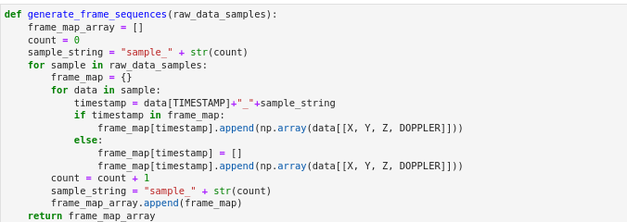
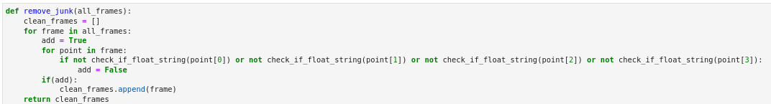
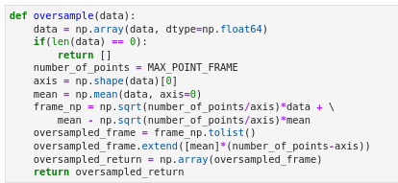
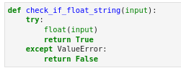
Methodology Data Pre-processing
Function that loads the raw mmWave data from the sample files
Function that will remove outliers, or invalid points
Function that groups together points into a single frame
Function that groups frames together in a sequence
Function that uses a sliding window to move across sample
Function that oversamples all frames to have the same number of points
Notes:
by comparing timestamp and frame number of each point

Slide 12
Methodology Data Pre-processing
Function that saves oversampled frame sequences into npy files
Function that is able to load saved npy data as samples

Slide 13
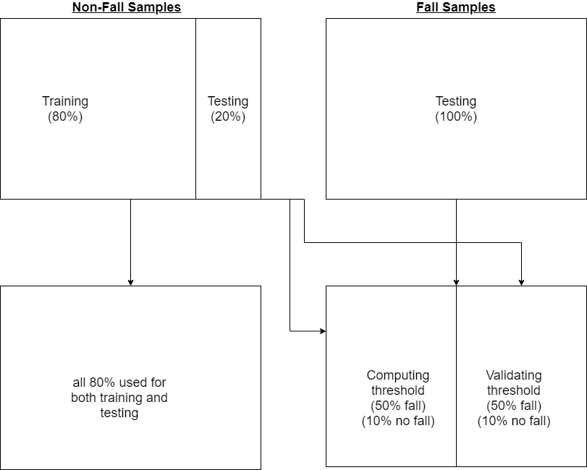
Methodology – Data Splitting
Requirement
Data had to be split between a training and test set
Samples for training, computing threshold and validating threshold had to have an even distribution of samples
Function developed to evenly distribute samples from each activity for training, computing threshold and validating threshold

Slide 14
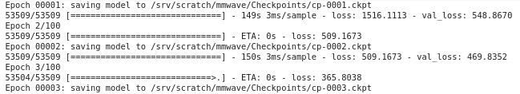
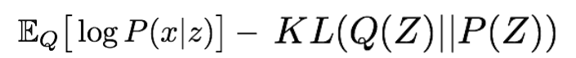
Methodology Variational Autoencoder
Requirement: Develop a generative model that is able to reconstruct frame sequences and calculate the reconstruction loss of input
Model is developed in TensorFlow and Keras
Model is able to checkpoint after each epoch
Model is able to be loaded from any checkpoint of choosing
Reconstruction loss is computed from the output of the model
Notes:
For checkpoint: to save training and pick up where it left off
For loss: using log-likelihood alongside KL divergence

Slide 15
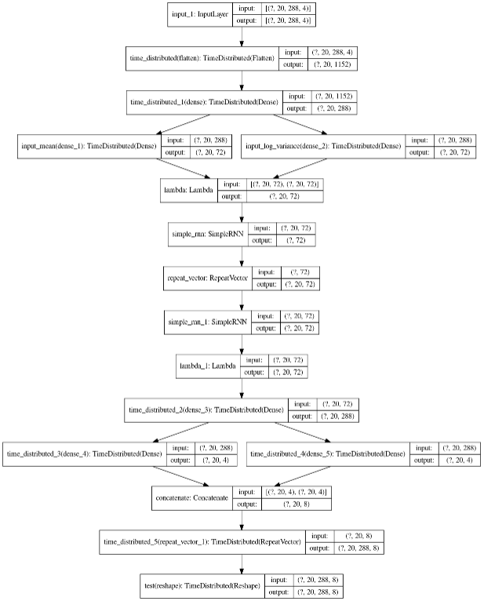
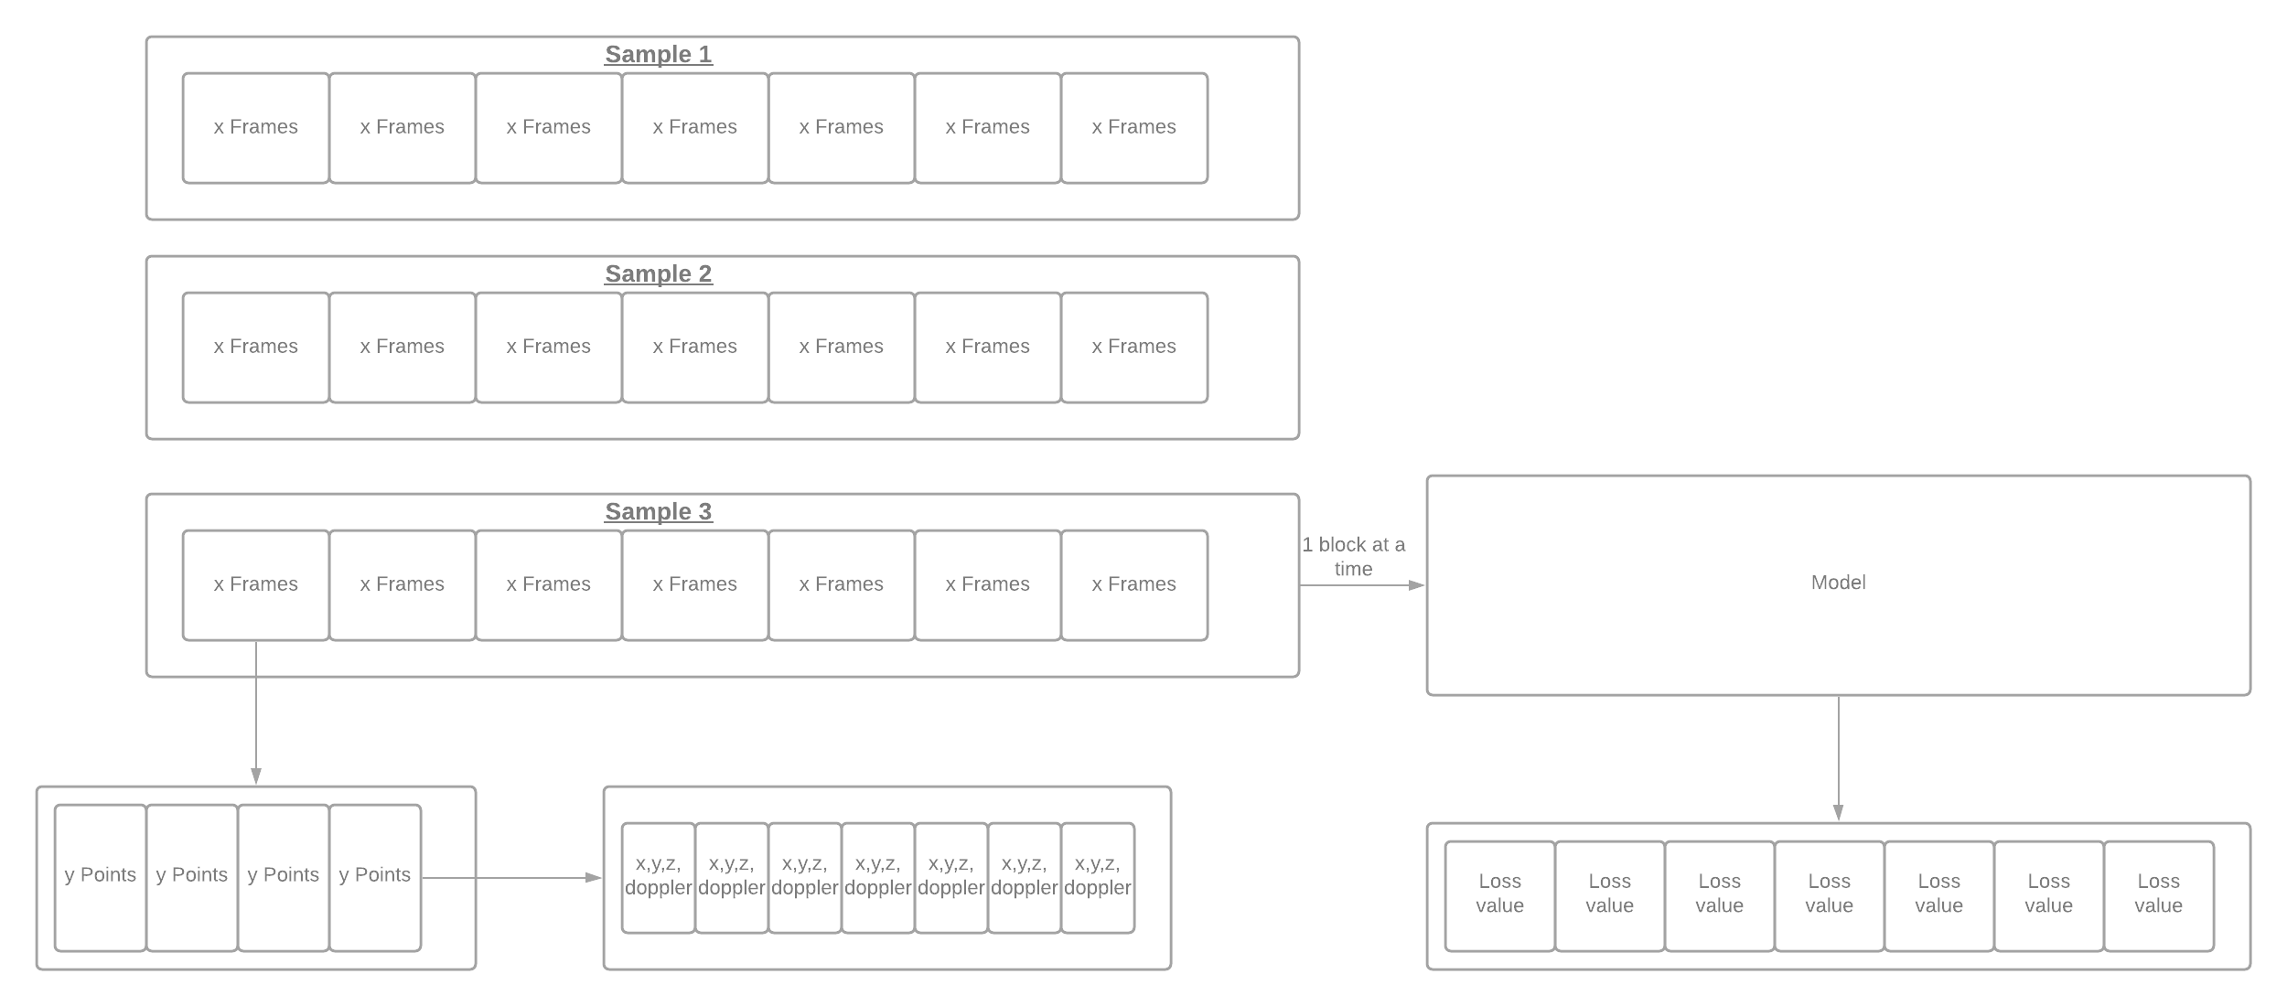
Methodology – Variational Autoencoder

Slide 16
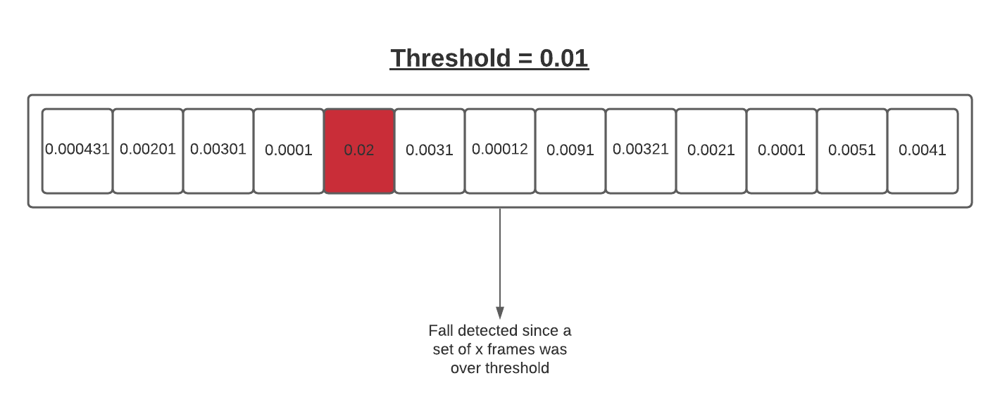
Methodology Thresholding
Requirement: Develop code to compute an optimal threshold that maximises the TPR – FPR
Special thanks to Reza for helping develop a majority of this code
Visualisation of the losses for ADL data and fall data
Threshold computed using Youden Index formula
Samples analysed 1 set of frames at a time
Notes:
Last point : using threshold to check losses on each set, this is to simulate real time

Slide 17
Results
Results were generated on the model trained with 100 epochs using window size 20 and window step size of 1.
In contrast to other papers, a large dataset was used in this experiment
There was a much greater number of ADL samples as opposed to non-fall samples
This goes back to the issue of falls being rare events especially in contrast to regular activity data

Slide 18
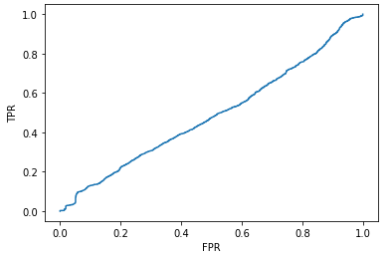
Result
TPR and FPR mapped against each other
If you increase TPR, you are also increasing FPR (almost like a slider)
A balancing act to maximise the TPR - FPR
Notes:
DO THIS SLIDE

Slide 19
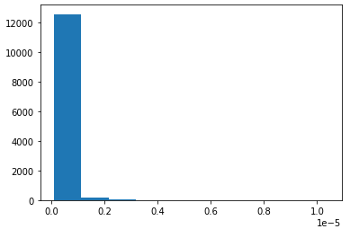
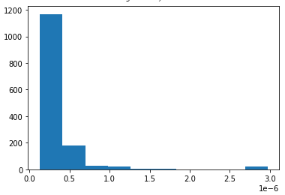
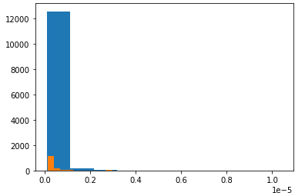
Results Threshold
All Losses for ADL Data mapped
All Losses for fall Data Mapped
All Losses for both ADL and fall data mapped ontop of each other
Notes:
DO THIS SLIDE

Slide 20
Results Accuracy
Activity | Accuracy
Fall | 40.00%
ADL | 41.12%
all | 40.78%
The Models classification accuracy
Fall
ADL
Total
Notes:
DO THIS SLIDE

Slide 21
Results Metrics
Metric | Result
Model Precision | 0.26
Model Recall | 0.40
Model F1 Score | 0.31
Log Loss | 20.45
AUC | 0.41
Precision
Recall
F1-Score
Log Loss
AUC value
Notes:
DO THIS SLIDE

Slide 22
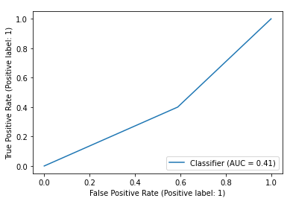
Results ROC Curve
Models Area under ROC curve
Notes:
DO THIS SLIDE

Slide 23

Outcome of Thesis C
Powerful and specialised data cleaning script has been developed
Data Pre-processing has been finalised and checked for correctness
Developed a variational autoencoder that can reconstruct frame sequence inputs.
Model developed can be detached from program allowing for a simple real-time integration
Youden Index code has been developed (thank you Reza)
Identified underlying issues that has affected the model’s result
The model trained doesn’t need fall data to get better, rather the opposite
Notes:
On point 4: provided data

Slide 24
What could have been done better
Checking back on my work to make sure I was handling it correctly
Major issue in data cleaning that was almost impossible to see had led me to believe I had amazing results, but this was with incorrect data
Time management between my thesis and multiple courses
15-hour thesis work-days on some days
Taking breaks when working in long periods
Understanding the data and doing more work with the data
Notes:
Some days I would be spending the whole day debugging 1 issue that has a strange solution that is only a 2-3 line fix
Talk about how a lot of the issues in data discovered in both thesis B AND thesis C
On the last part also add how you’ve realised towards the end thanks to Nathan that your model is being trained on activities by random subjects, however a different subject can be used in testing set, so there’s no way to guarantee the subjects you trained on would end up in the testing set. However in a real world scenario, this specific model can be trained with a bunch of data online, on the same singular subject, to be personalised to the subject.

Slide 25
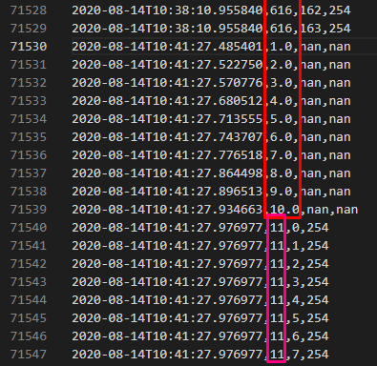
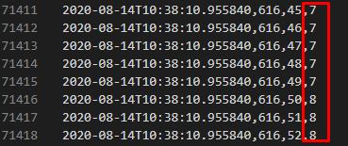
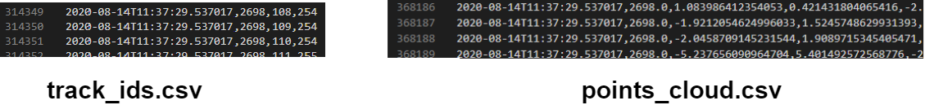
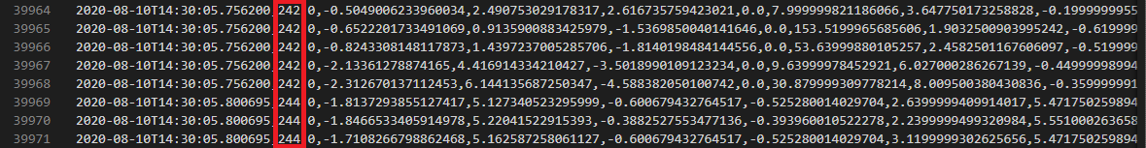
Data Issues
Looking at the data, we have:
Multiple Targets even though only 1 person is recorded
The target id csv file has different number of points to point cloud csv file
Missing frames from point cloud csv files
Target id csv file would have random number of junk rows before beginning, making it impossible to denoise some of the files
Notes:
DO THIS SLIDE

Slide 26
Data Issues
A Large potion of this research was spent trying to develop a flexible pipeline for pre-processing
Previous work on data pre-processing seemed to have been done incorrectly
Timestamps on ground truth file and mmWave files were out of sync
An enormous chunk of the data was noise, and noise removal was not performed
Data was labelled frame by frame, adding unnecessary space and pre-processing logic
Notes:
The next slide will show a visual representation of these issues with previous pre-processing

Slide 27
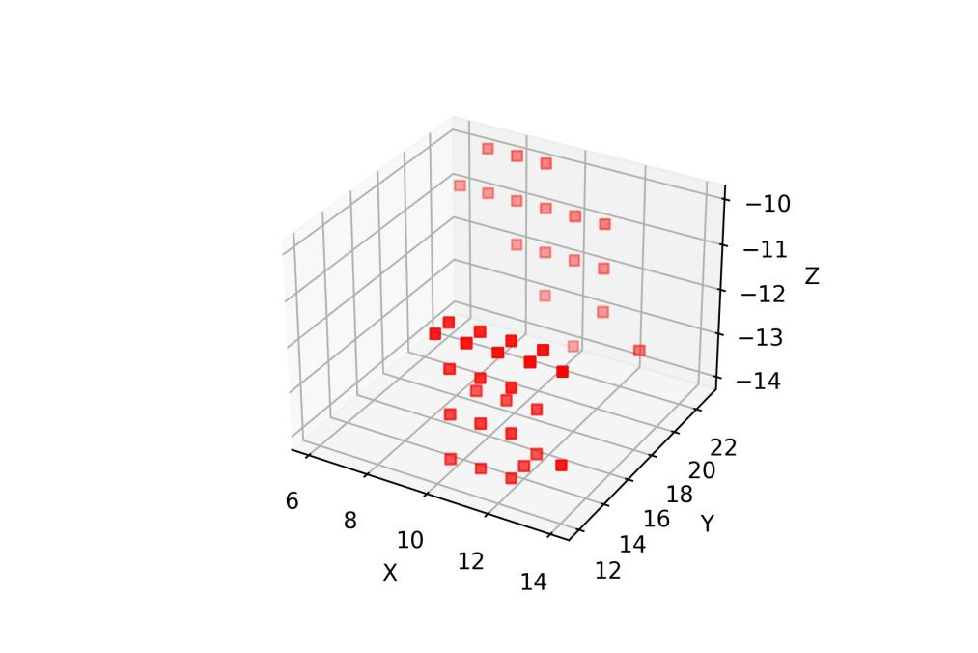
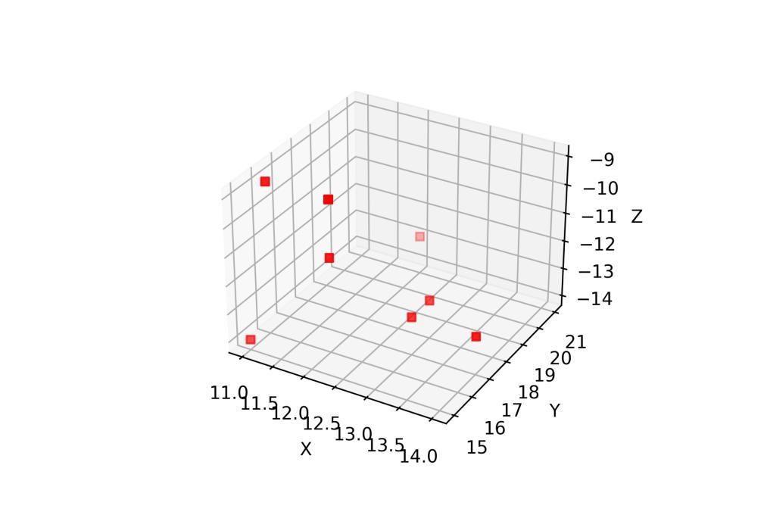
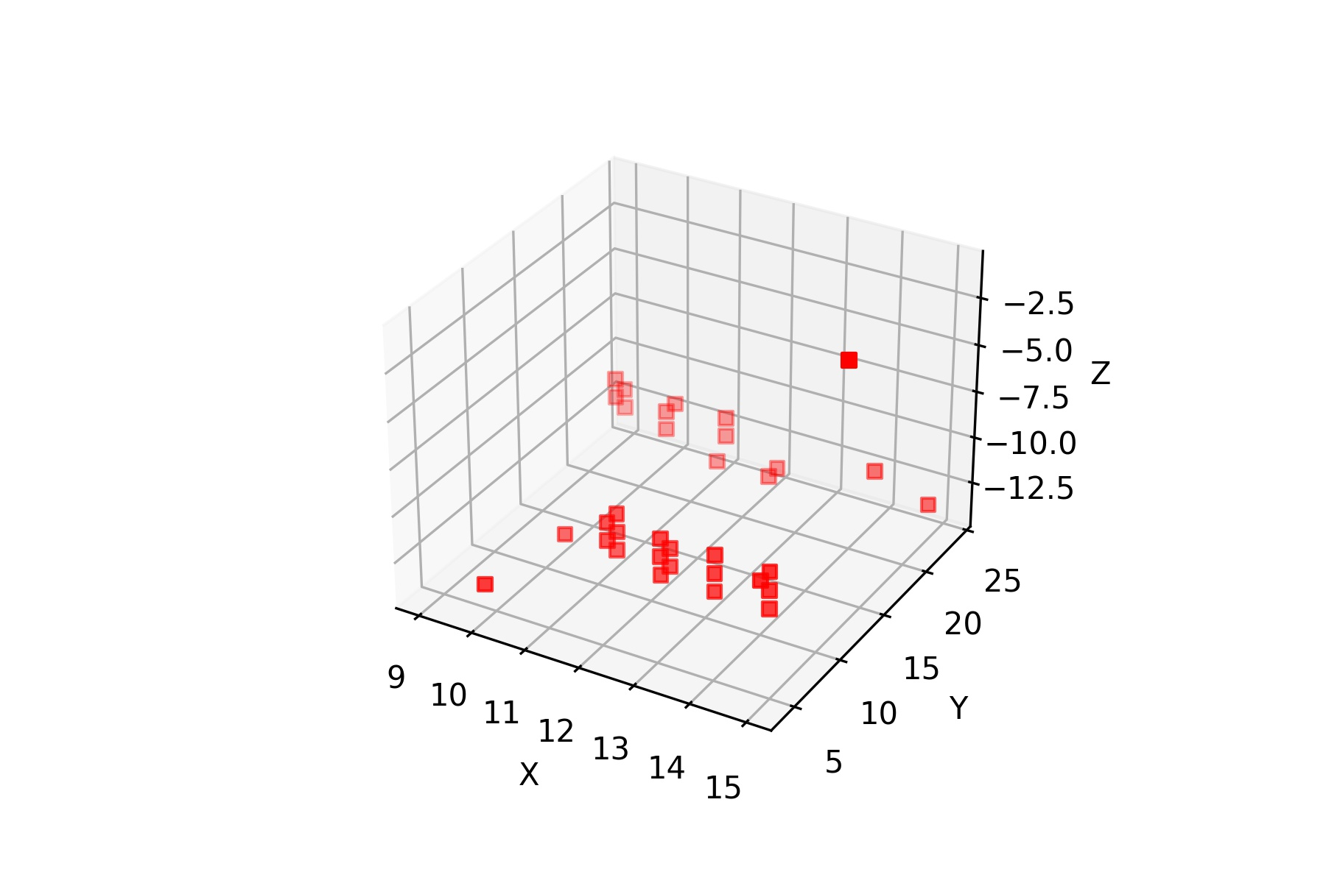
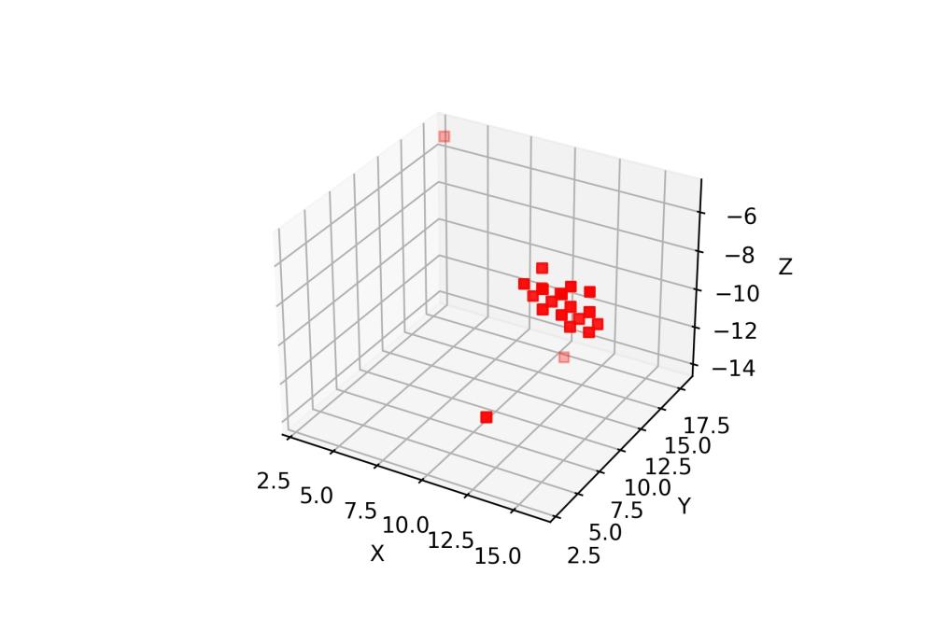
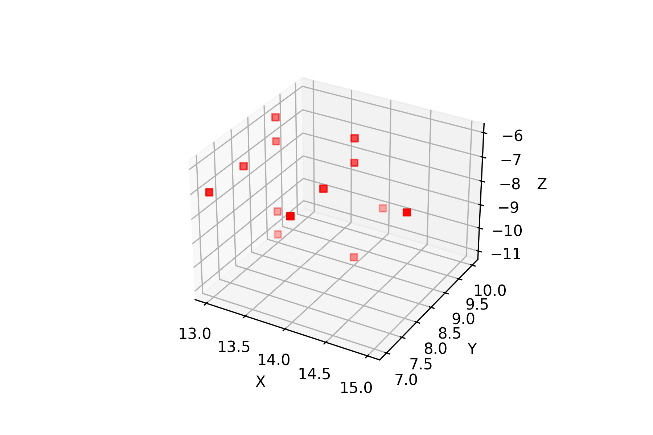
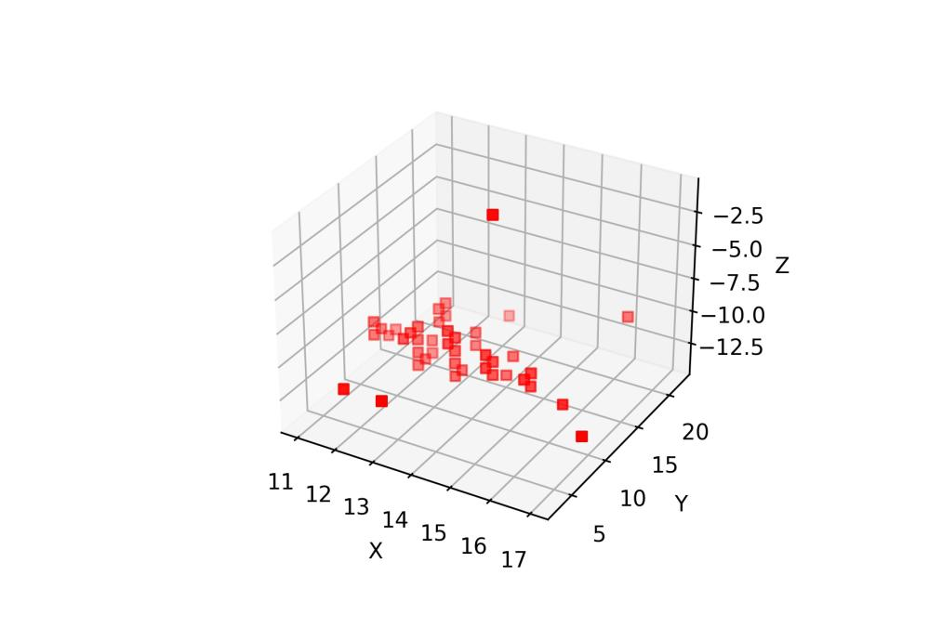
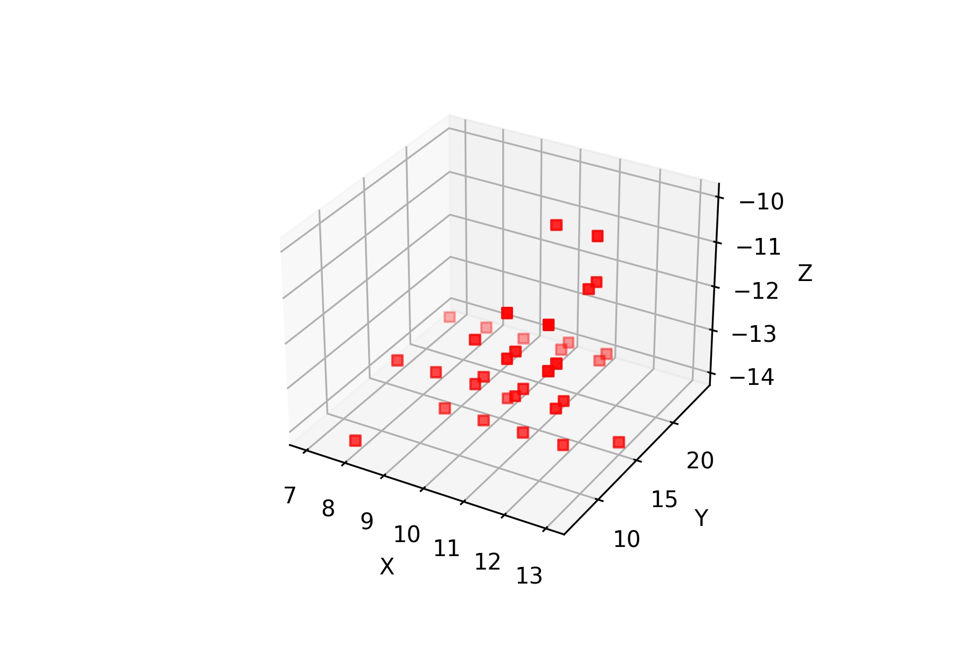
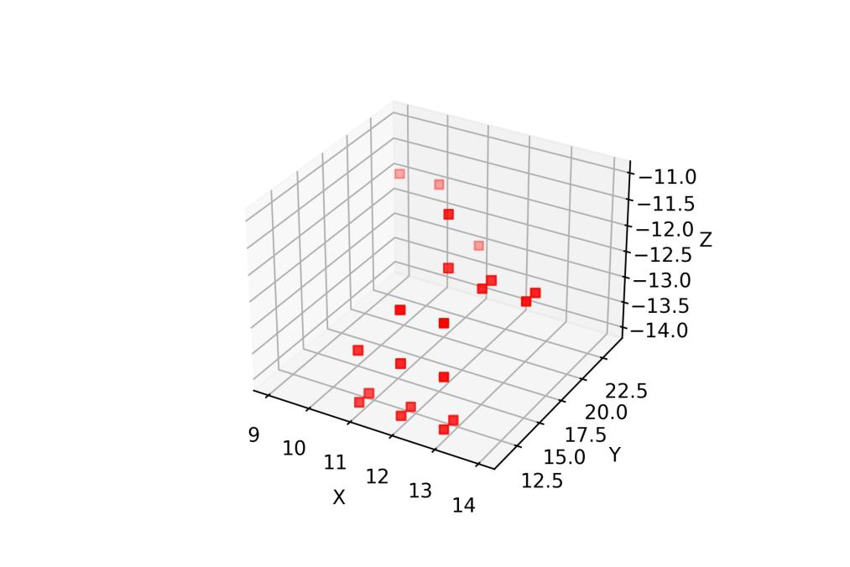
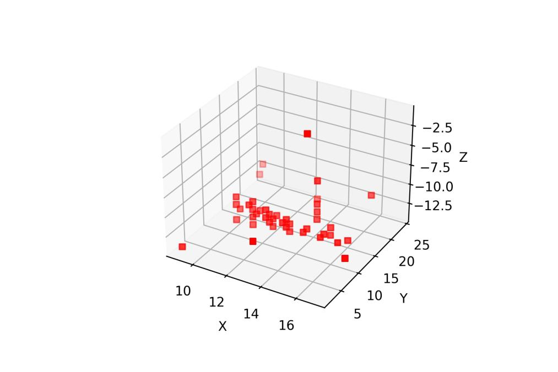
Data Issues
Notes:
First 2 images:
Image 1 : noise removal works like a charm perfectly fine
Image 2: noise removal has gona crazy, just a bunch of noise output
After image 2: these next images are all frames with falls as their classification back to back to back
Image 1: perfectly fine, you can see it’s a person on floor laying there, no worries
Image 2: it’s the table? Points all over the place, where did the person go?
Image 3: baack to normal, the person is being detected as falling again
Image 4: the mattress? Its gone crazy again
Image 5: recovered to the person
Image 6: wall being detected or objects on wall? Its gone crazy once again
Final image: an example of one of the preprocessed frames

Slide 28
Data Issues
Notes:
First 2 images:
Image 1 : noise removal works like a charm perfectly fine
Image 2: noise removal has gona crazy, just a bunch of noise output
After image 2: these next images are all frames with falls as their classification back to back to back
Image 1: perfectly fine, you can see it’s a person on floor laying there, no worries
Image 2: it’s the table? Points all over the place, where did the person go?
Image 3: baack to normal, the person is being detected as falling again
Image 4: the mattress? Its gone crazy again
Image 5: recovered to the person
Image 6: wall being detected or objects on wall? Its gone crazy once again
Final image: an example of one of the preprocessed frames

Slide 29
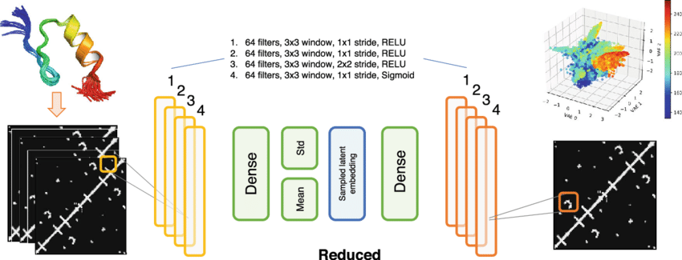
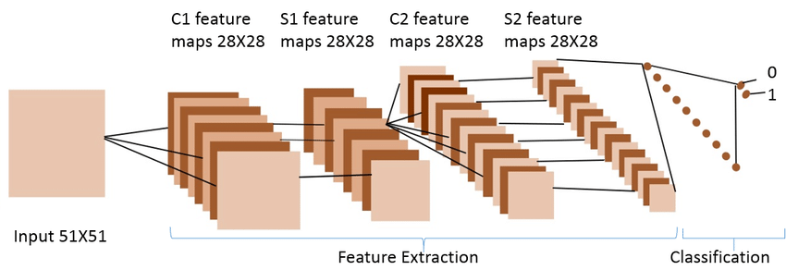
Future Prospects
Despite not having great results for model accuracy, and overlapping losses, this can be attributed to potentially poor data
Data gathering re-performed correctly
Developing occupancy grid’s from raw mmWave data and using convolutional layers for encoding and decoding
Performing feature extraction using a 3D-CNN with occupancy grids and modifying the autoencoder to work with these automatically extracted features
Realtime implementation (most of the groundwork is there)
Azure function implementation (most of the groundwork is there)
Notes:
DO THIS SLIDE

Slide 30
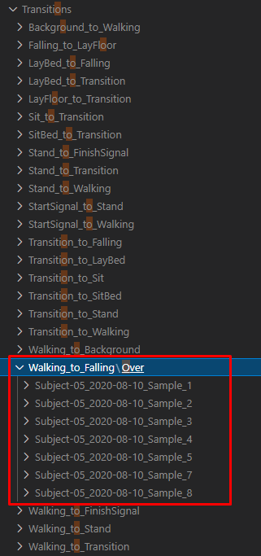
Future Prospects
Transition data for fall prevention
Frame sequences from activity A to activity B is captured during data cleaning
These sequences can be used to determine if the fall is about to happen
Notes:
DO THIS SLIDE

Slide 31
THANK YOU
It has been a pleasure developing and researching this model
Special thanks to Reza for constant support throughout the term
Notes:
The major positives that came from thesis B was
I had developed the complex model and allowed room for flexibility and easy changes
I had preprocessed all the data which was a monolithic task in itself, and in hindsight I would say this should have been the aim of thesis B from the beginning
The model generated can easily work as a real time solution

Slide 32
References
[1] R. Luque, E. Casilari, M.-J. Mor´on, G. Redondo, “Comparison and characterisation of android-based fall systems, sensors 14”, IEEE, 2014, 18543-18574
[2] WHO, Falls, World Health Organization, 2018, [Online]. Available: https://www.who.int/news-roo#m/fact-sheets/detail/falls
[3] S. S. Khan, J. Hoey, “Review of Fall Detection Techniques: A Data Availability Perspective”, University of Waterloo, 2016, pp.6, 8-9, 12, 19
[4] L. Schwickert, C. Becker, U. Lindemann, C. Mar´echal, A. Bourke, L. Chiari, J. Helbostad, W. Zijlstra, K. Aminian, C. Todd, S. Bandinelli, J. Klenk, “Fall detection with body-worn sensors: A systematic review, Zeitschrift f¨ur Gerontologie und Geriatrie”, IEEE, 2013, 706–719.

Slide 33
References
[5] E. Stone, M. Skubic, “Fall detection in homes of older adults using the microsoft kinect, Biomedical and Health Informatics”, IEEE, 2015, pp. 290–301.
[6] J. Perry, S. Kellog, S. Vaidya, J.-H. Youn, H. Ali, H. Sharif, “Survey and evaluation of real-time fall detection approaches, in: High-Capacity Optical Networks and Enabling Technologies (HONET)”, 2009 6th International Symposium on, 2009, pp. 158–164.
[7] F. Jin, A. Sengupta, S. Cao, “mmFall: Fall Detection using 4D MmWave Radar and a Hybrid Variational RNN AutoEncoder”, IEEE, 2020, pp. 1

Slide 34
References
[8] H. Haibo, E. Garcia, Learning from imbalanced data, “Knowledge and Data Engineering”, IEEE, 2009, 1263–1284.
[9] W. Klement, S. Wilk, W. Michalowski, S. Matwin, “Classifying severely imbalanced data, in: Advances in Artificial Intelligence”, Springer, 2011, pp. 258–264.

